Slide 1
Q1. What issue is being faced?
The main issue of this problem is how to elevate the firm x sales force and market share in many city located across the continental United States, Alaska, Puerto Rico and Hawaii.
What was given?
Givent 2 csv files which shows the past state of firm x sales force related in city,territory, digital events, fund category and so on.
. What software tool should be used?
Python is strongly preferred.

Slide 2
2. What is the goal of doing analysis?
1, To analyze the past experience of firm x sales force and determine for the future.
2, To get understanding of what can be suggested from the past data
3, To see the effect of digital events, fund category and which city was the best for elevating firm x sales market share and sales force.
Overall, to get some trends from the past data and make good decisions for the future.

Slide 3
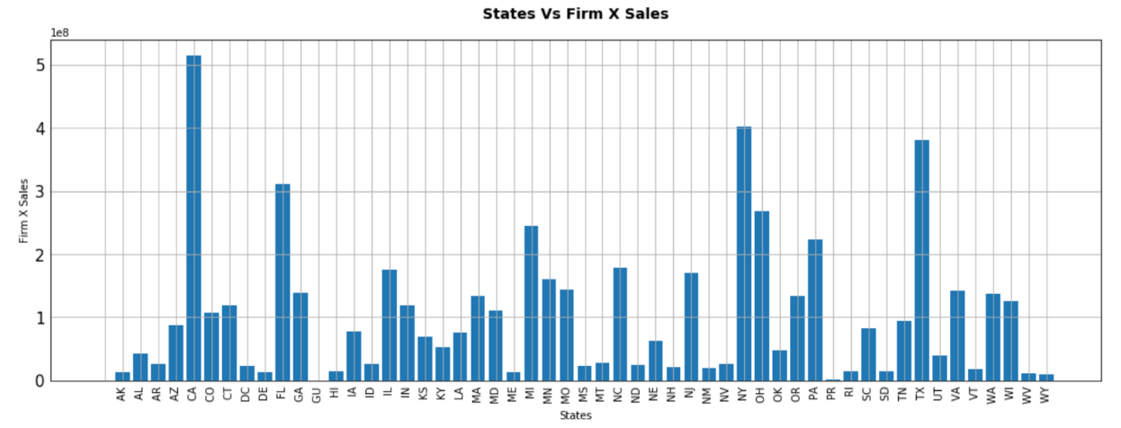
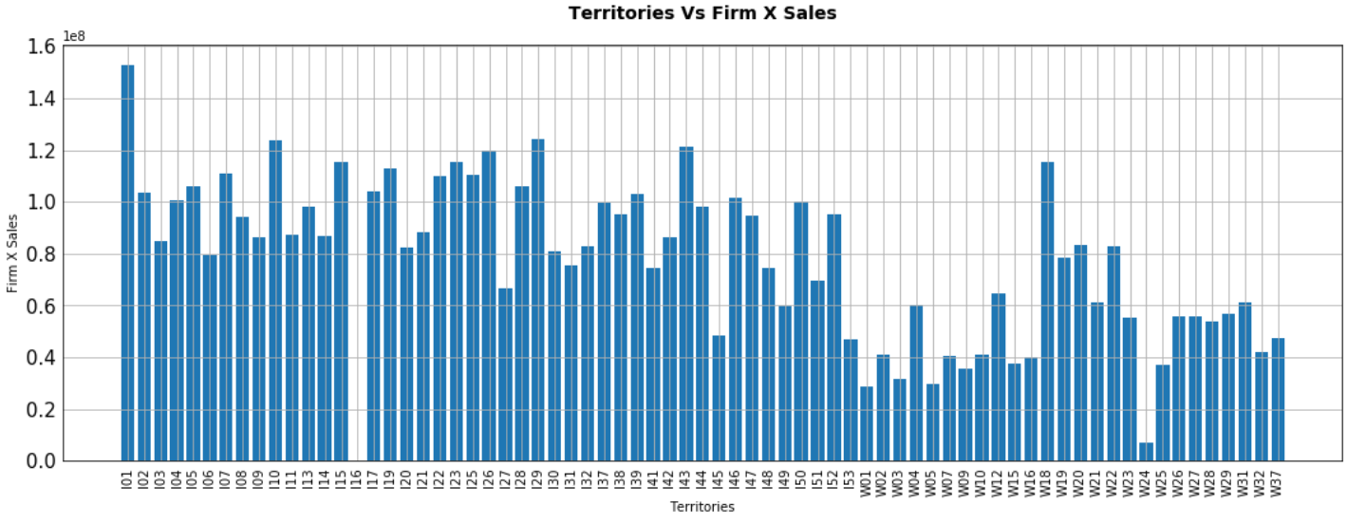
Q3. What is the context of the situation?

Slide 4
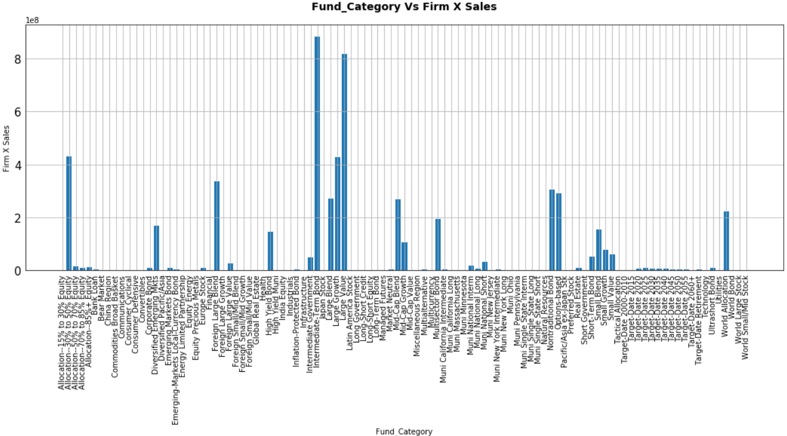

Slide 5
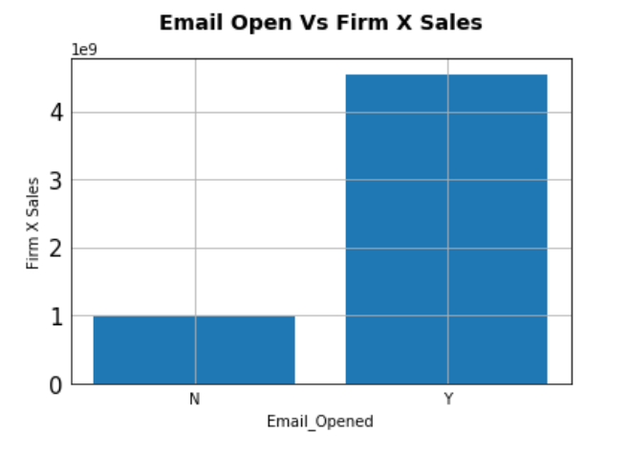
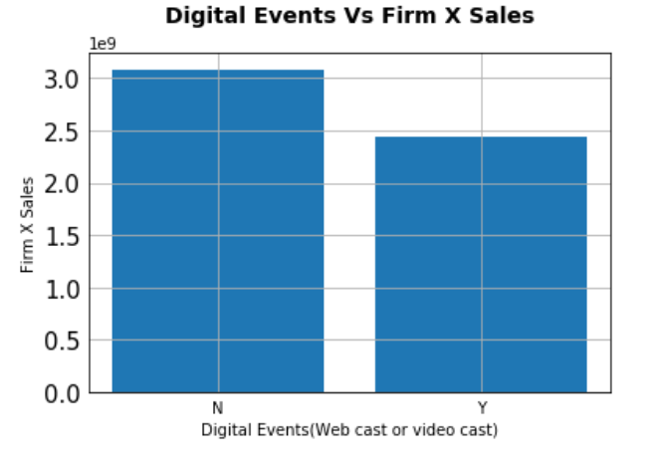
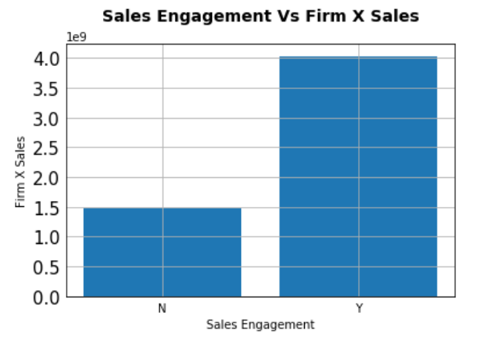

Slide 6
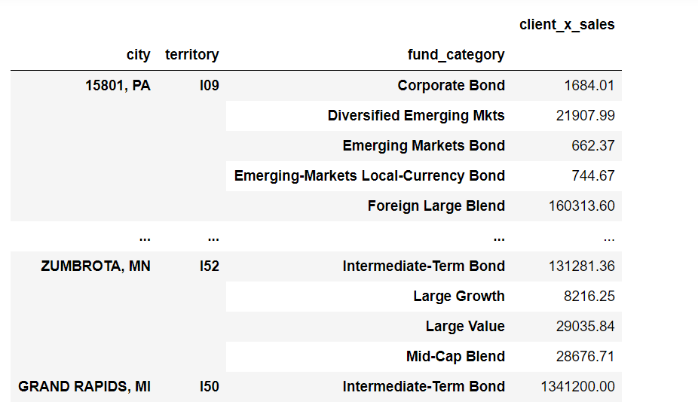
Q4. What solution was implemented?

Slide 7
Ans1. We first see where the client x sales force is 0. There is no need to invest fund category to those areas.
Ans2. We have to analyze the client x sales force in each city and territory according to the fund category. The table
above shows that relationship.
Ans 3. From this table we can see what fund category makes the client x sales force(firm x) maximize in each city and
territory.
Ans 4. We have to find each fund category which can make the firm x sales force elevate, I think those are the fund
category that makes the firm x sales force maximize.
Ans 5. After finding them, we should invest fund category specified according to the ans 4 and it will make the firm x
sales force elevate and grow its market share.
Ans 6. To get more effect, we can decide the digital events e.g whether to take part in there or not, whether to open
email or not , whether to be engaged sales or not according to the charts above.

Slide 8
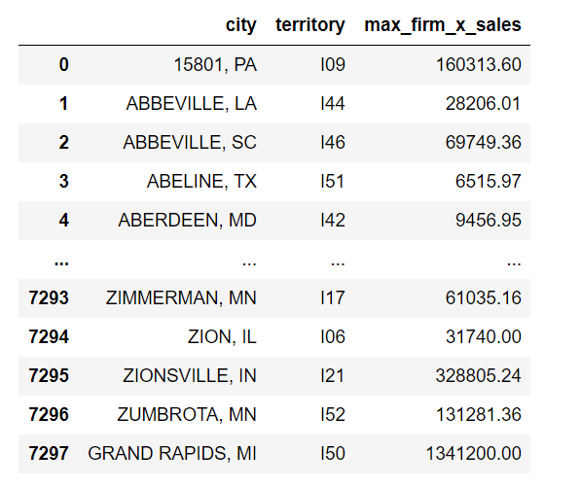
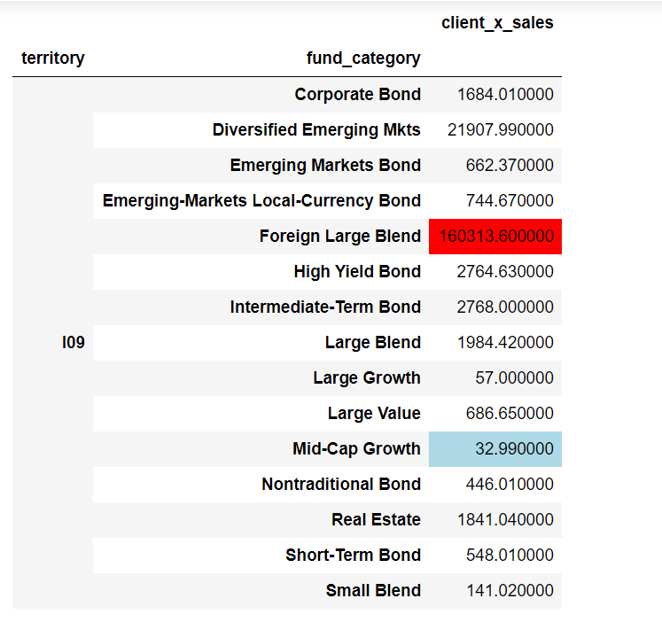

Slide 9
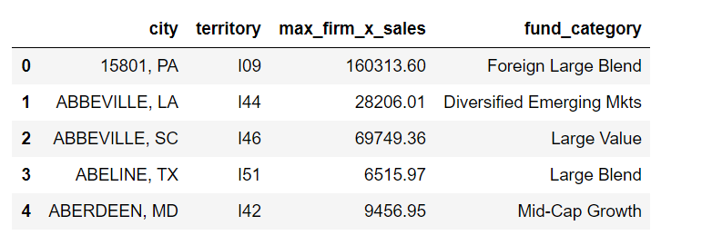
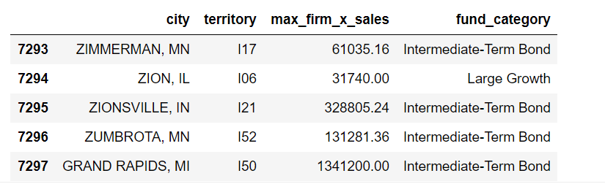

Slide 10
Q5. Did it work? Why, or why not?
It will work in the future, It must be done in the practice.

